Slide 1



ECG SVERIGE
Ekonomi för det allmänna bästa
ECONOMY
FOR THE COMMON GOOD
An economic model for the future
Notes:
Presentera mig + agenda
MÅL – väcka frågor och dialog. Inte komma med “SVARET”
Emma Dalväg -ECG-consultant, member of the Swedish ECG community
17.15-18 Emma presents the history of ECG, the main thoughts of the movement, the ECG community and the ECG-balance sheet for companies
Break
-18.45 Workshop
18.45-19 Sum up together with Emma

Slide 2
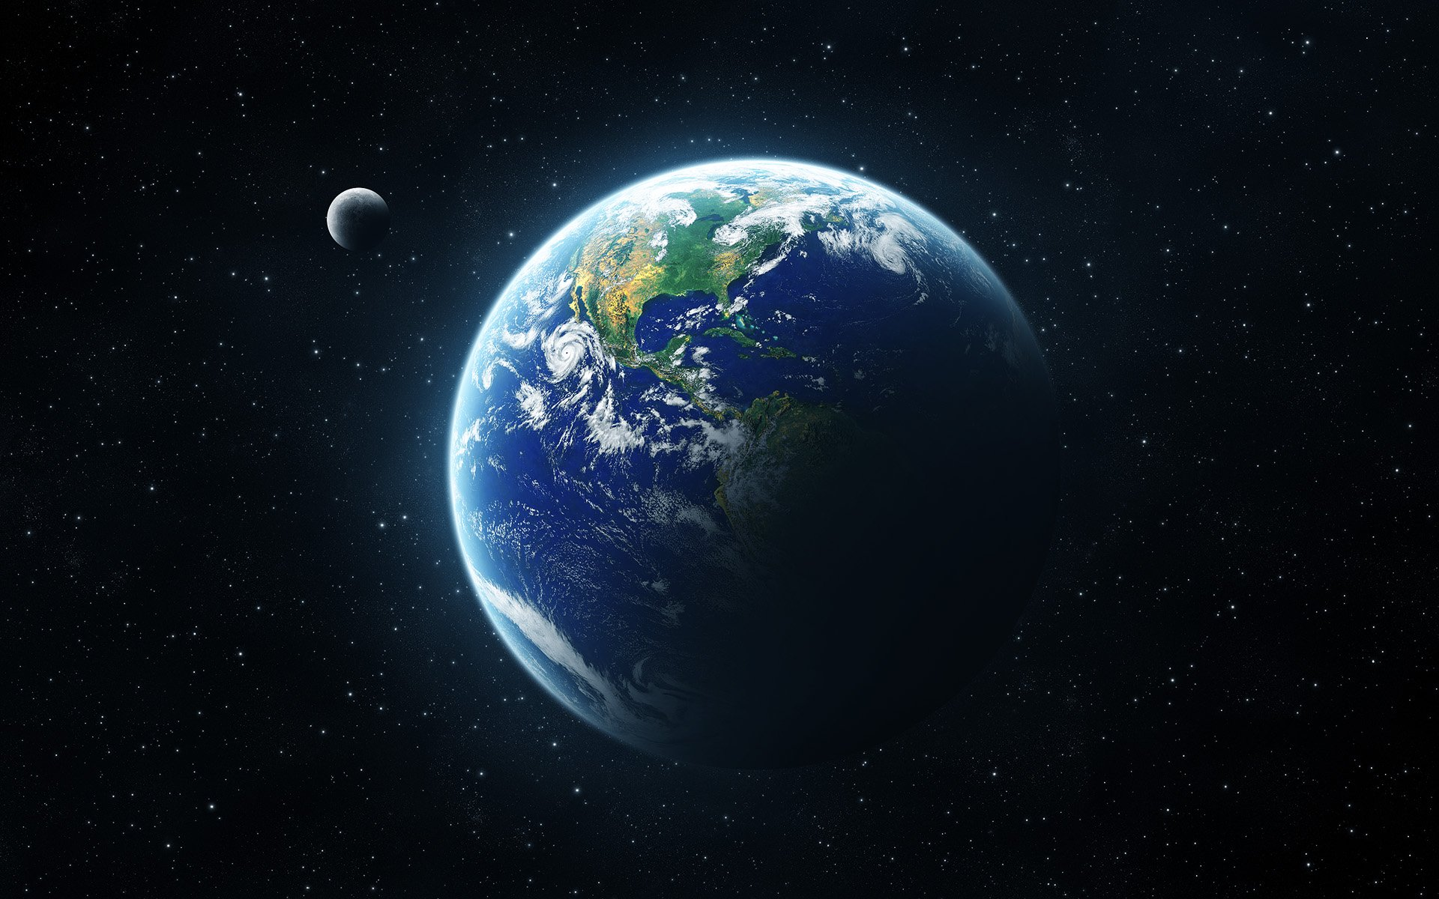

72% of people globally say that business is failing to take care of the planet and society as a whole
Havas Media/Accenture survey
Notes:
SYSTEMKRIS
- Global studie

Slide 3
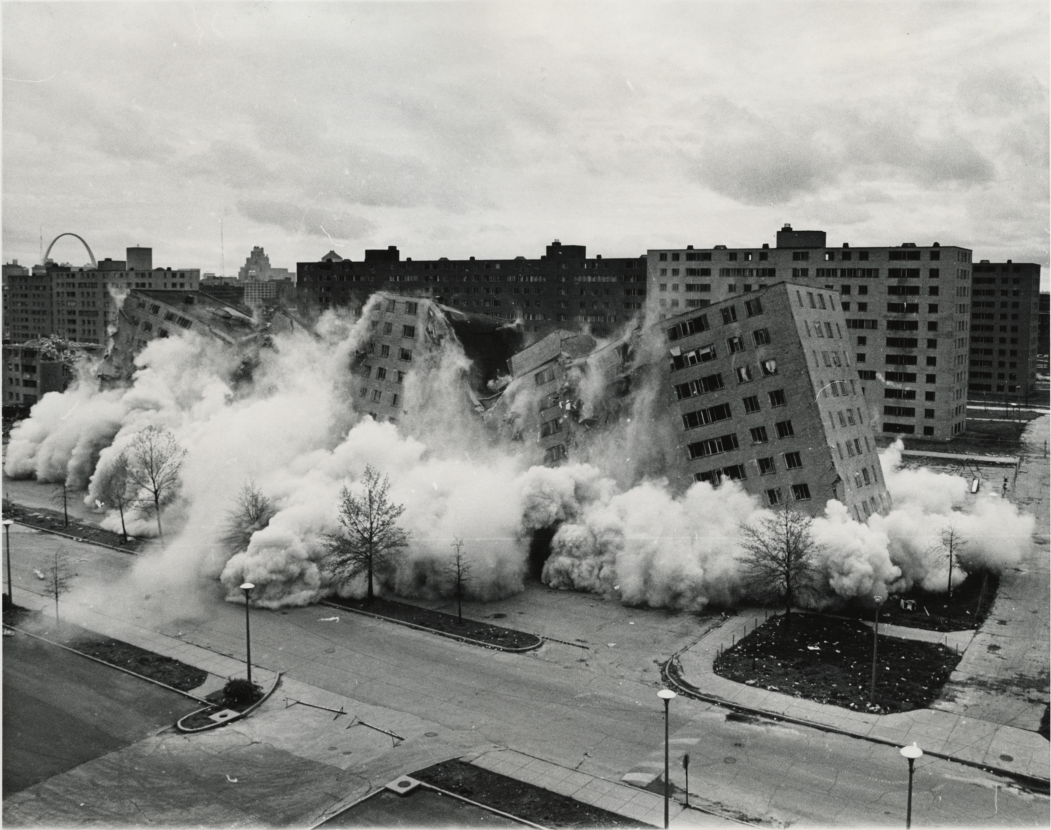
88% of Austrians wants a new economic order
Bertelsmann Foundation 2012

Slide 4

Distribution: 1% owns as much as 99% and 8 people own as much as half the world's population (Oxfam)
Hunger: 800 million people suffer from malnutrition annually
Ecology: "World Overshoot Day" the 2 of August 2017
Meaning: 2/3 feel disconnected at work (Gallup)
Power: 147 companies control the majority of the world economy
Bertelsmann Foundation 2012

Slide 5
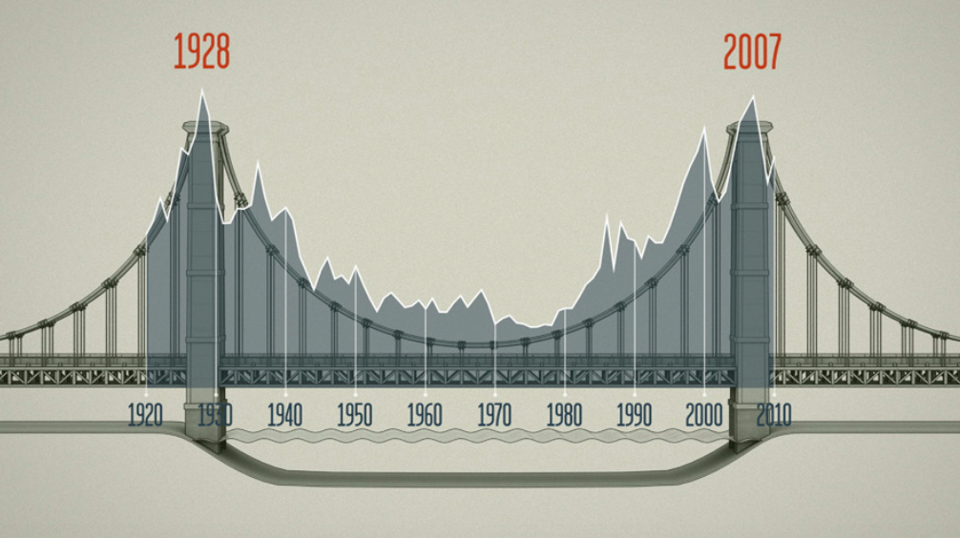
Income Distribution in the US
Notes:
Tack vare Thomas Piketty kan vi se inkomstfördelningen i ett historiskt perspektiv. Visar hur mycket av inkomsterna som gick till den översta procenten i samhället. (USA) Andel sjönk kraftigt för att sedan öka igen från 80-talet.

Slide 6
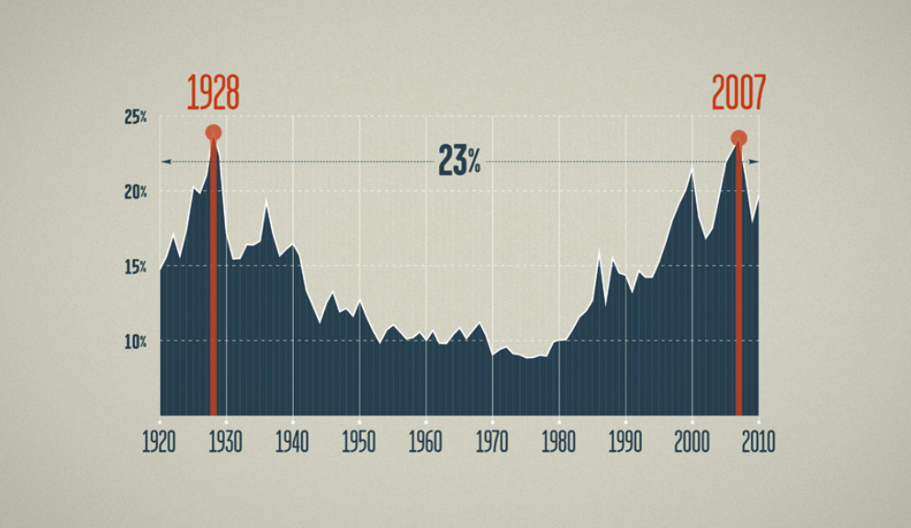
Notes:
Den översta procenten tar hem 23% av inkomsten det året.

Slide 7
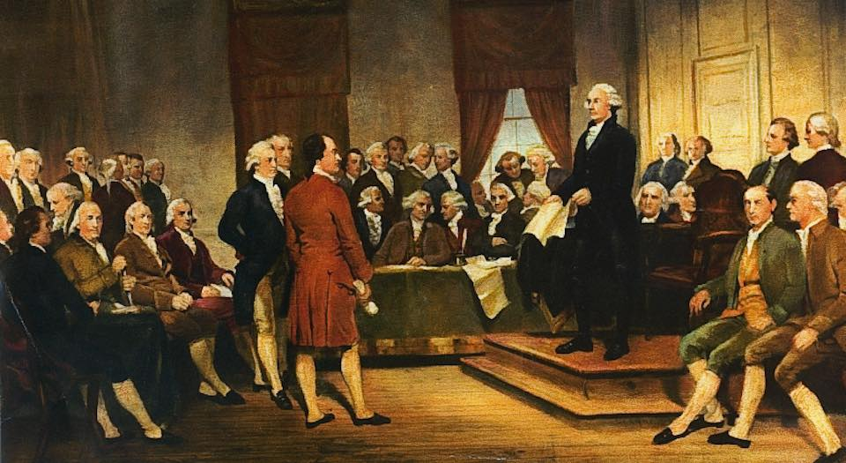
What is the goal of the economy?
„We the people of the United States, in Order to
form a more perfect Union, establish Justice (…)
promote the general Welfare.“
Notes:
Många grundlagar uttrycker tydligt allmän välfärd som målet för ekonomin.
Den tyska grundlagen säger ”Egendom förpliktigar. Dess användning ska också tjäna
det gemensammas bästa.

Slide 8

Oikonomia (economy): The art of house holding with resources
= Money as a mean
Chrematistike (capitalism): The art of making money
= Money and maximising profit is the goal

Slide 9
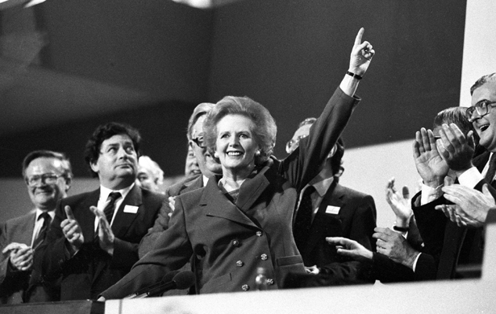
TINA – There is no alternative

Slide 10
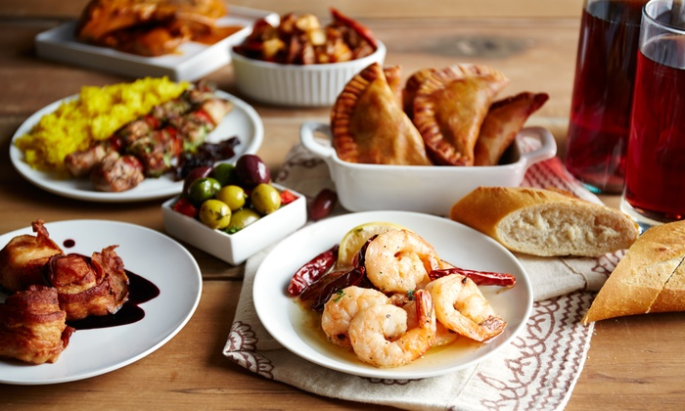
TAPAS – There are plenty of alternatives
Notes:
• Solidarity Economy
• Transition Town
• Blue Economy, Circular Economy
Degrowth / Post-growth Economics
Common

Slide 11

ECG is one of those alternatives

Slide 12
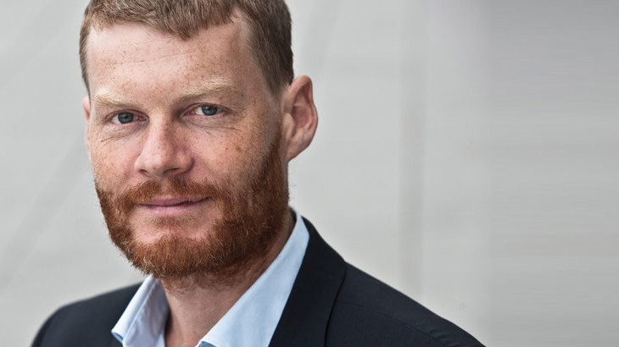
ECG was created from the collaboration between the Austrian author Christian Felber and a group of companies, politicians and scientists 2011

Slide 13


Slide 14

A vision of a financial system that benefits society and our planet as a whole

Slide 15

ECG is based on values that favour the common good
It is a tool for financial, political and social change
- a bridge between the old and the new

Slide 16
From:
To:
Money rules Money serves
Money is the purpose Money is a means
Capital income Income for work or need
Profit motive Common welfare motive
Financial surplus Cover costs and investment
Global Local/regional
Hierarchical Democratic
Stock market companies Cooperatives
Risky + speculative Conservative + concrete
Money is the only criteria Ecological and social indicators
Notes:
Vill på börja en dialog om…

Slide 17


Company level
National level
GDP –> Common Good Product
Profit–> ECG-balance sheet
Notes:
OECDs “Better Life Index,” Bhutans “Gross National Happiness,” och ”the Happy Planet Index”

Slide 18
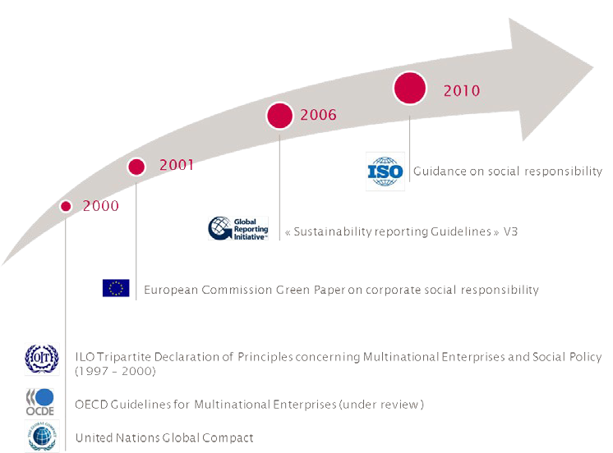

DEVELOPMENT OF CSR
Notes:
GRI

Slide 19

ECGs values:
Human dignity
Solidarity
Ecological sustainability
Social justice
Co-determination and Transparency
Notes:
ECG står för en radikal omformning av vår ekonomi baserad på mänsklig värdighet, solidaritet, hållbarhet, rättvisa och demokrati.

Slide 20
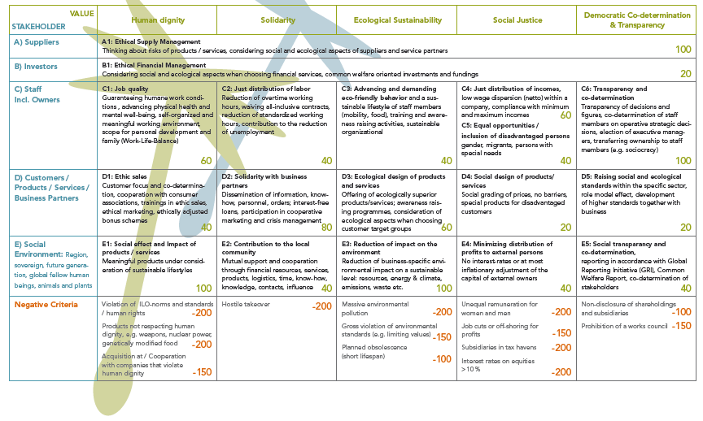
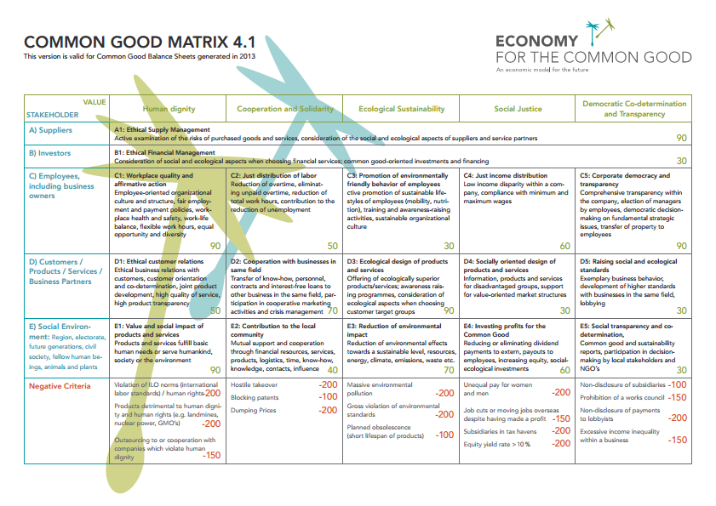

Slide 28
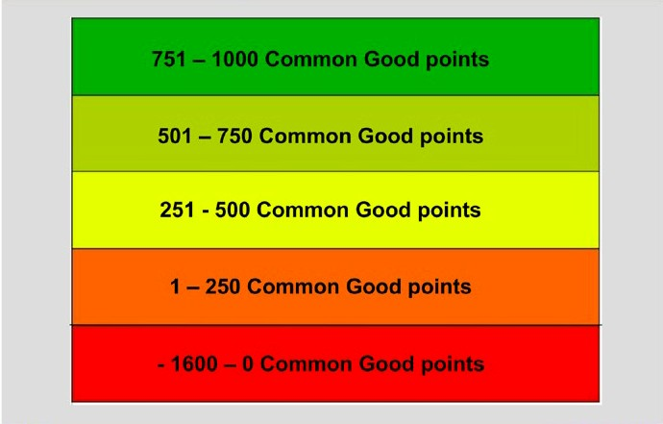
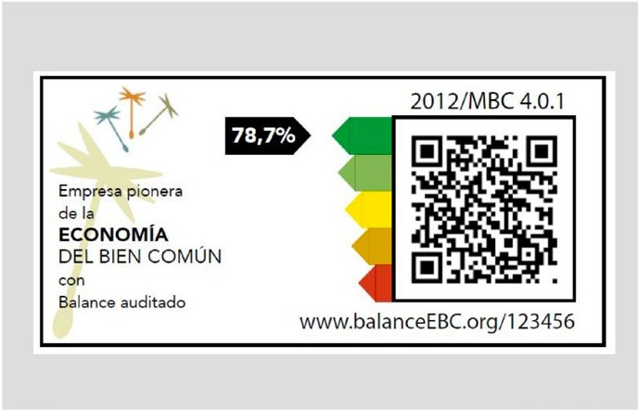
POÄNGSYSTEMET
Notes:
För närvarande är medeltalet cirka 300, vilket visar att företag har utrymme för förbättringar.

Slide 29

Notes:
Om alla företag fick 1000 poäng skulle vi ha ett nästan perfekt samhälle: det skulle inte finnas fattigdom eller arbetslöshet, vi skulle ren miljö, jämställdhet, fred och engagerade och motiverade arbetstagare.

Slide 30



Slide 31

POTENTIAL BENEFITS
Lower Tax rates
Lower Tariffs
Lower Interest rates for the bank loan
Priority in public procurement
Cooperative research with public universities

Slide 32

ECG – A GROWING MOVEMENT
9210 individual supporters
2306 companies
Over 200 certified ECG-balance sheets
264 local groups
Consultants and auditors
ECG-Sweden was founded 2016

Slide 33
A1 Ethical supply management

Slide 34
A1 Ethical supply management
Subcriteria
A1.1 Regional, ecological and social aspects
A1.2 Active examination of impact of purchased p/s
A1.3 Basic structural conditions for fair pricing

Slide 35
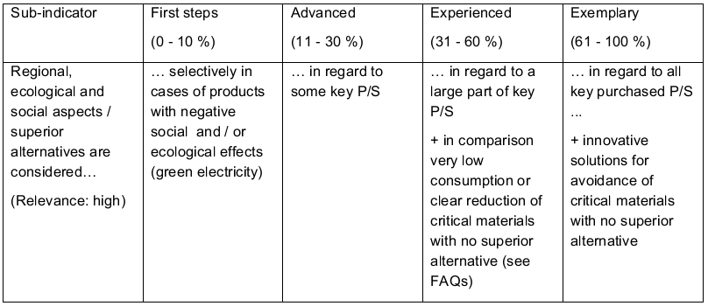
A1 Ethical supply management
A 1.1 Regional, ecological and social aspects

Slide 36
B1 Ethical financial management

Slide 37
B2 Ethical financial management
Subcriteria
B1.1 Institutionalization
B1.2 Ethical / sustainable quality of financial service
providers
B1.3 Investments oriented to the common good
B1.4 Corporate financing oriented to the common
good

Slide 38
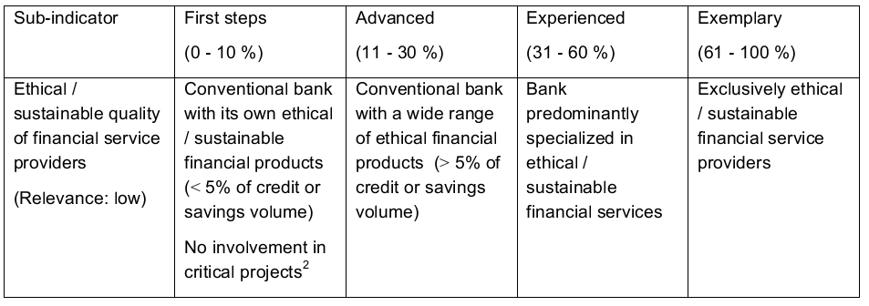
B2 Ethical financial management
B1.2 Ethical / sustainable quality of financial service providers

Slide 39
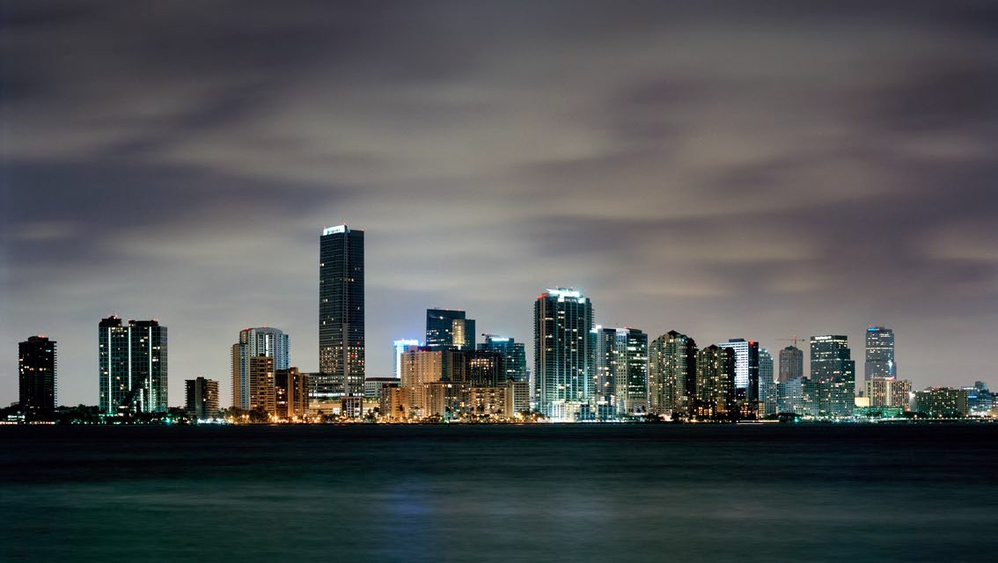
BREAK

Slide 40
WORKSHOP
Familiarise your self with the balance sheet and circle the areas that engage you as individuals the most
Try out the balance sheet pretending you were a company.
A1,1 and B1.2:What score would you get? What do you think about the statement and the scoring?
C4.1: What do you think about the statement and the scoring?

Slide 41

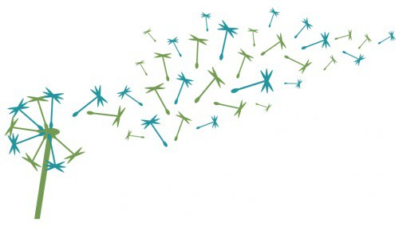
ECONOMY
FOR THE COMMON GOOD
An economic model for the future
Emma Dalväg
info@emmadalvag.se
0739 62 82 05
www.ecogood.org

